Slide 1

Seasonal Agriculture Performance Analysis
Priyanshu Raj
Maharishi University of Information Technology, Noida
AICTE STU ID : STU6a6c53f02938f1785484272

Slide 2

PROBLEM STATEMENT
(Agricultural activities are influenced by seasonal variations in environmental conditions, farming practices, resource availability and market conditions. As a result, agricultural performance may differ from one season to another. However, raw agricultural data does not clearly explain how agricultural performance changes across seasons or what patterns can be observed in different seasonal conditions. The problem is to analyze the given agricultural dataset and investigate seasonal differences in agricultural performance by identifying meaningful patterns, trends, relationships and variations within the available data.

Slide 3
Project Description
This project analyzes a real-world agricultural dataset covering farming practices, environmental conditions, crop production, resource usage and economic performance recorded across different seasons and geographical regions.
Since agricultural performance is influenced by seasonal variation in weather, resource availability and market conditions, the raw data alone does not reveal how performance changes from one season to another.
The project cleans and explores the dataset, then applies statistical and visualization techniques in a Jupyter Notebook to uncover seasonal patterns, trends and relationships, concluding with evidence-based insights and recommendations to support seasonal agricultural planning.

Slide 4

WHO ARE THE END USERS?
Farmers and agricultural producers planning seasonal crop and resource decisions
Agricultural policy makers and planning bodies designing seasonal support programs
Agribusinesses and supply chain managers forecasting resource and market needs
Researchers and data analysts studying seasonal agricultural trends

Slide 5

Technology Used
  Python for data cleaning, analysis and scripting
  Pandas and NumPy for data preparation and manipulation
  Matplotlib and Seaborn for statistical visualization
  Jupyter Notebook for documenting the complete analysis

Slide 6
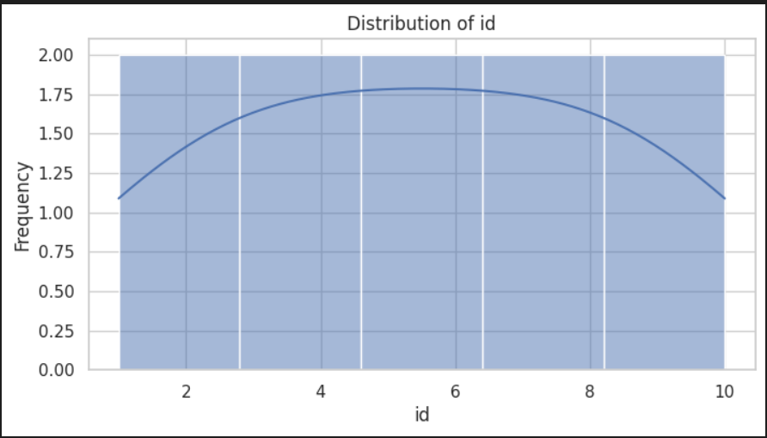
RESULTS

Slide 7
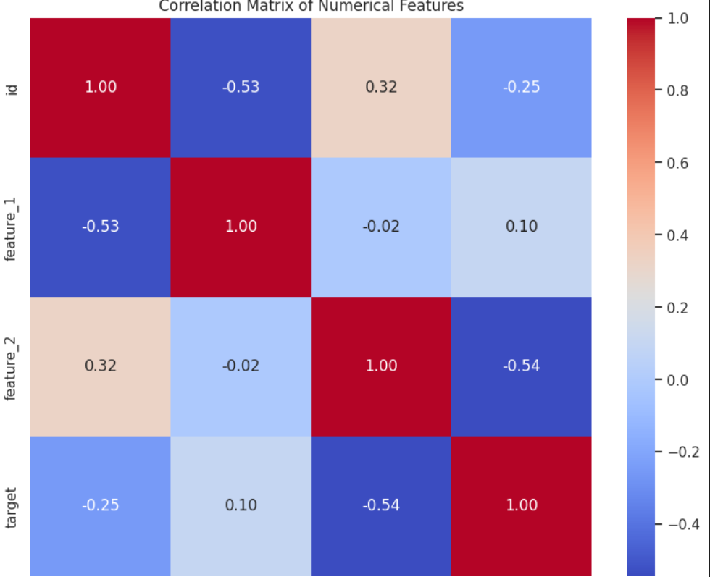
RESULTS
[Add screen shots of your code ]

Slide 8
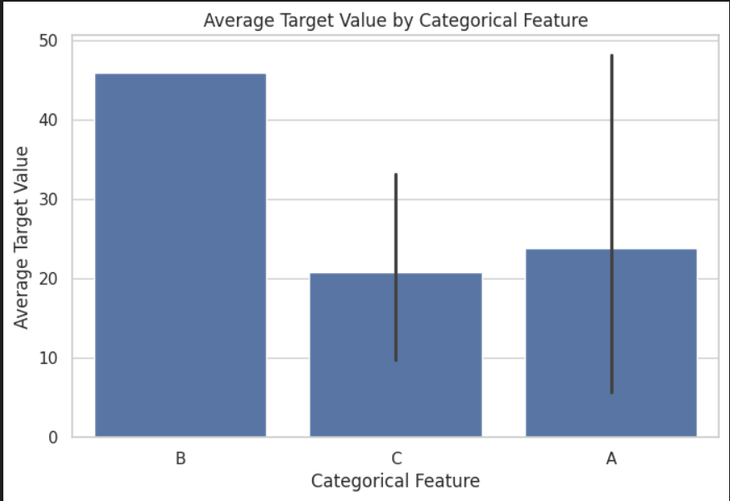
RESULTS

Slide 9
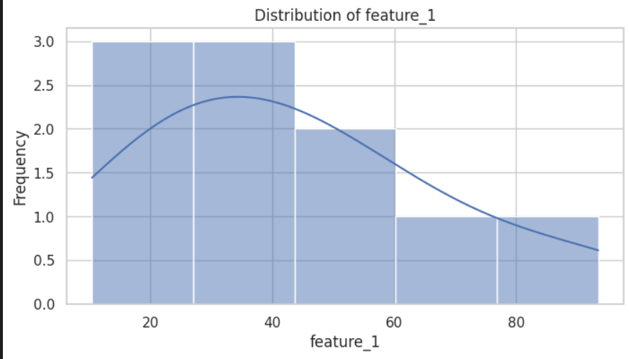
RESULTS

Slide 10
Future scope
Deeper Analysis
Wider Application
Extend the analysis to include additional years and more regions for stronger seasonal trend validation
Incorporate predictive and machine learning models to forecast seasonal agricultural performance
Build an interactive dashboard so stakeholders can explore seasonal patterns in real time
Integrate live weather and market data to support more timely agricultural planning

Slide 11
GitHub Link
https://github.com/PriyanshuRaj1807/Seasonal-Analysis-.git

Slide 12

VOIS Course completion certificate -
Course name- Data Visualization

Slide 13
Thank you
.
.

